Slide 1
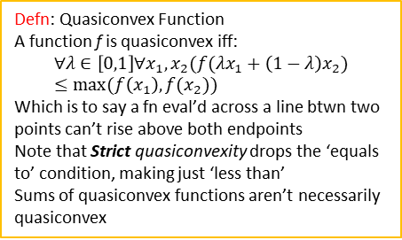
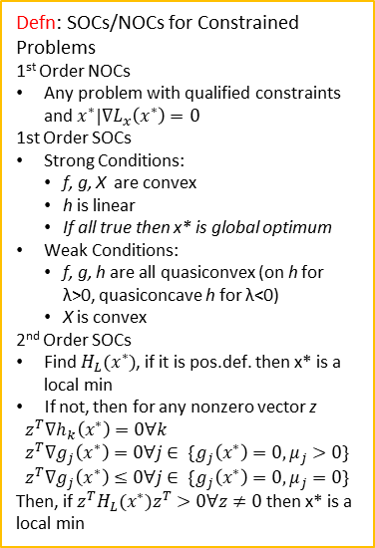
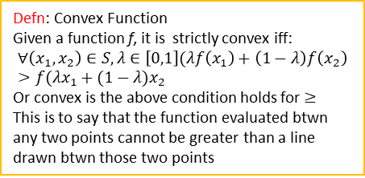
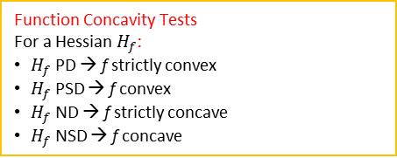
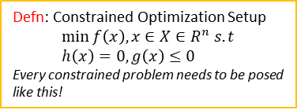
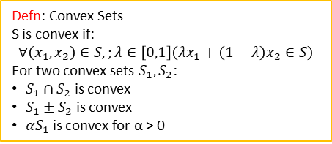
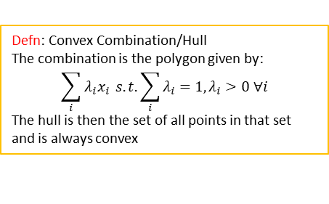
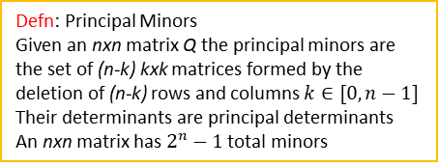
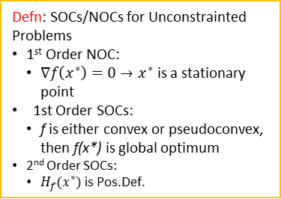
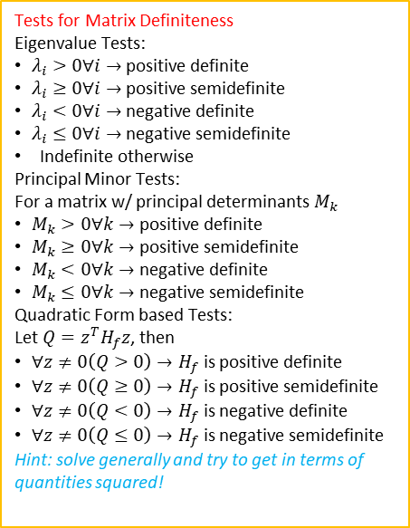


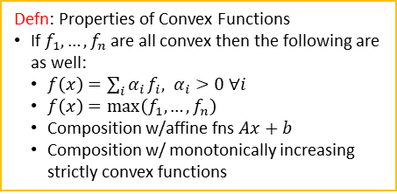
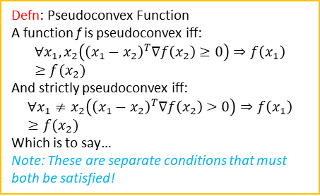
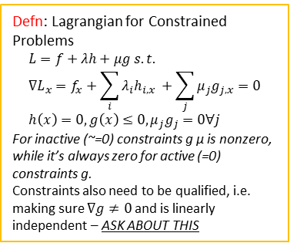
Defn: Convex Sets
S is convex if:
$$∀\left(x_{1},x_{2}\right)∈S,;λ∈\left[0,1\right]\left(λx_{1}+\left(1−λ\right)x_{2}∈S\right)$$
For two convex sets $S_{1}, S_{2}$:
$S_{1}∩S_{2}$ is convex
$S_{1}±S_{2}$ is convex
${αS}_{1}$ is convex for α > 0
Tests for Matrix Definiteness
Eigenvalue Tests:
$λ_{i}>0∀i→$ positive definite
$λ_{i}≥0∀i→$ positive semidefinite
$λ_{i}<0∀i→$ negative definite
$λ_{i}≤0∀i→$ negative semidefinite
Indefinite otherwise
Principal Minor Tests:
For a matrix w/ principal determinants $M_{k}$
$M_{k}>0∀k→$ positive definite
$M_{k}≥0∀k→$ positive semidefinite
$M_{k}<0∀k→$ negative definite
$M_{k}≤0∀k→$ negative semidefinite
Quadratic Form based Tests:
Let $Q=z^{T}H_{f}z$, then
$∀z≠0\left(Q>0\right)→H_{f}$ is positive definite
$∀z≠0\left(Q≥0\right)→H_{f}$ is positive semidefinite
$∀z≠0\left(Q<0\right)→H_{f}$ is negative definite
$∀z≠0\left(Q≤0\right)→H_{f}$ is negative semidefinite
Hint: solve generally and try to get in terms of quantities squared!
Defn: SOCs/NOCs for Unconstrainted Problems
1st Order NOC:
$∇f\left(x^{∗}\right)=0→x^{∗}$ is a stationary point
1st Order SOCs:
f is either convex or pseudoconvex, then f(x*) is global optimum
2nd Order SOCs:
$H_{f}(x^{∗})$ is Pos.Def.
Defn: Convex Function
Given a function f, it is strictly convex iff:
$$∀\left(x_{1},x_{2}\right)∈S,λ∈\left[0,1\right](λf\left(x_{1}\right)+\left(1−λ\right)f\left(x_{2}\right)>f(λx_{1}+(1−λ)x_{2}$$
Or convex is the above condition holds for $≥$
This is to say that the function evaluated btwn any two points cannot be greater than a line drawn btwn those two points
Defn: Constrained Optimization Setup
$$\min{f\left(x\right), x∈X∈R^{n} s.t} \\ h\left(x\right)=0, g\left(x\right)≤0$$
Every constrained problem needs to be posed like this!
Defn: Properties of Convex Functions
If $f_{1},…,f_{n}$ are all convex then the following are as well:
$f\left(x\right)=\sum_{i}{α_{i}}f_{i}, α_{i}>0 ∀i$
$f\left(x\right)=\max\left(f_{1},…,f_{n}\right)$
Composition w/affine fns $Ax+b$
Composition w/ monotonically increasing strictly convex functions
Defn: Lagrangian for Constrained Problems
$$L=f+λh+μg s.t. \\ ∇L_{x}=f_{x}+\sum_{i}{λ_{i}h_{i,x} }+\sum_{j}{μ_{j}g_{j,x}}=0 \\ h\left(x\right)=0,g\left(x\right)≤0,μ_{j}g_{j}=0∀j$$
For inactive (~=0) constraints g μ is nonzero, while it’s always zero for active (=0) constraints g.
Constraints also need to be qualified, i.e. making sure $∇g≠0$ and is linearly independent – ASK ABOUT THIS
Defn: Pseudoconvex Function
A function f is pseudoconvex iff:
$$∀x_{1},x_{2}\left({\left(x_{1}−x_{2}\right)}^{T}∇f\left(x_{2}\right)≥0\right)⇒f\left(x_{1}\right)≥f(x_{2})$$
And strictly pseudoconvex iff:
$$∀x_{1}≠x_{2}\left({\left(x_{1}−x_{2}\right)}^{T}∇f\left(x_{2}\right)>0\right)⇒f\left(x_{1}\right)≥f(x_{2})$$
Which is to say…
Note: These are separate conditions that must both be satisfied!
Defn: Principal Minors
Given an nxn matrix Q the principal minors are the set of (n-k) kxk matrices formed by the deletion of (n-k) rows and columns $k∈[0,n−1]$
Their determinants are principal determinants
An nxn matrix has $2^{n}−1$ total minors
Defn: SOCs/NOCs for Constrained Problems
1st Order NOCs
Any problem with qualified constraints and $x^{∗}|∇L_{x}\left(x^{∗}\right)=0$
1st Order SOCs
Strong Conditions:
f, g, X are convex
h is linear
If all true then x* is global optimum
Weak Conditions:
f, g, h are all quasiconvex (on h for λ>0, quasiconcave h for λ<0)
X is convex
2nd Order SOCs
Find $H_{L}(x^{∗})$, if it is pos.def. then x* is a local min
If not, then for any nonzero vector z
$$z^{T}∇h_{k}\left(x^{∗}\right)=0∀k \\ z^{T}∇g_{j}\left(x^{∗}\right)=0∀j∈ \{g_{j}\left(x^{∗}\right)=0,μ_{j}>0\}$$
$$z^{T}∇g_{j}\left(x^{∗}\right)≤0∀j∈ \{g_{j}\left(x^{∗}\right)=0,μ_{j}=0\}$$
Then, if $z^{T}H_{L}(x^{∗})z^{T}>0∀z≠0$ then x* is a local min
Function Concavity Tests
For a Hessian $H_{f}$:
$H_{f}$ PD → f strictly convex
$H_{f}$ PSD → f convex
$H_{f}$ ND → f strictly concave
$H_{f}$ NSD → f concave
Strictly Convex
Convex
Defn: Quasiconvex Function
A function f is quasiconvex iff:
$$∀λ∈\left[0,1\right]∀x_{1},x_{2}(f(λx_{1}+\left(1−λ\right)x_{2})≤max⁡(f\left(x_{1}\right),f(x_{2}))$$
Which is to say a fn eval’d across a line btwn two points can’t rise above both endpoints
Note that Strict quasiconvexity drops the ‘equals to’ condition, making just ‘less than’
Sums of quasiconvex functions aren’t necessarily quasiconvex
Strictly Pseudoconvex
Pseudoconvex
Strictly Quasiconvex
Defn: Bordered Hessian
$$BH=\begin{matrix}0 & ∇f^{T} \\ ∇f & H_{f}\end{matrix}$$
Quasiconvex
Apply 1st Order NOCs to establish candidate optima, then 2st and 2nd order SOCs to establish is they are local or global minima – failing these doesn’t mean the points area optima just that they don’t follow KKT criteria
Quasiconvexity Tests
Find all principal minors of the Bordered hessian for k > 2
Defn: Half Space
The two spaces formed above/below a line
$$HS=\{x:a_{n}x≤z\}$$
Defn: Convex Combination/Hull
The combination is the polygon given by:
$$\sum_{i}{λ_{i}x_{i}} s.t. \sum_{i}{λ_{i}}=1, λ_{i}>0 ∀i$$
The hull is then the set of all points in that set and is always convex
Defn: Epi-/hypo-graphs
Epigraph is the area above a function
Convex epigraph <-> convex fn
Hypograph is below the function
Convex hypograph <-> concave fn

Slide 2
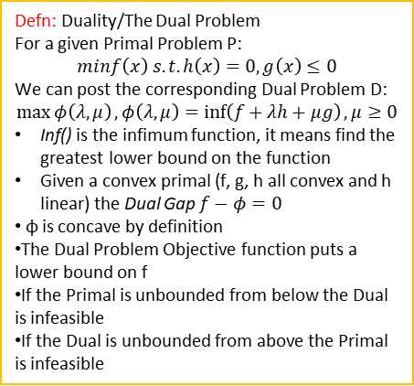
Defn: Duality/The Dual Problem
For a given Primal Problem P:
$$minf\left(x\right) s.t. h\left(x\right)=0,g\left(x\right)≤0$$
We can post the corresponding Dual Problem D:
$$\max{φ\left(λ,μ\right)}, φ\left(λ,μ\right)=\inf\left(f+λh+μg\right),μ≥0$$
Inf() is the infimum function, it means find the greatest lower bound on the function
Given a convex primal (f, g, h all convex and h linear) the Dual Gap $f−φ=0$
φ is concave by definition
The Dual Problem Objective function puts a lower bound on f
If the Primal is unbounded from below the Dual is infeasible
If the Dual is unbounded from above the Primal is infeasible

